Slide 1
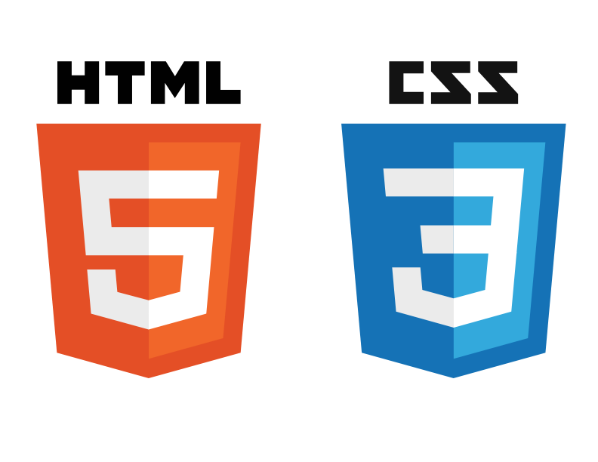
Basics of HTML & CSS
Part 1

Slide 2
Outline
What is HTML?
HTML Documents
Tag – Web Element
Head and body in the HTML Document
HTML title
HTML headings
HTML paragraphs
HTML images
HTML links
HTML attributes
HTML styles
HTML lists

Slide 3
What is HTML?
Stands for HyperText Markup Language
Standard markup language for creating Web pages
Describes the structure of a Web page
Consists of a series of elements
Tell the browser how to display the content
HTML elements are represented by tags

Slide 4
HTML Documents
All HTML documents must start with a document type declaration: <!DOCTYPE html>
The <!DOCTYPE> represents the document type
It must only appear once, at the top of the page and before any HTML tags
It is not case sensitive
The HTML document itself starts with <html> and ends with </html>
<html></html> is the parent of all web elements in the HTML document
All other tags are in <html></html> tag
SYNTAX:
<!DOCTYPE html>
<html>
<!-- everything else goes here -->
</html>

Slide 5
Tag vs Web Element
Everything that we see on a web page is web element
Elements are created with specific tags
<tagName> is known as opening tag
</tagName> is known as closing tag
Tag is basically considered as container in HTML
Every tag is creating a web element of its own
SYNTAX:
<tagName></tagName>
NOTE: some web elements are created ONLY with opening tag, and they do not require closing tag

Slide 6
Head and body in the HTML Document
head and body are 2 most important tags after <html></html> tag
The invisible part of the HTML document goes into <head></head> tag
The head of an HTML document is the part that is not displayed in the web browser when the page is loaded.
It contains information such as the page title, links to CSS, etc.
The visible part of the HTML document goes into <body></body> tag
It is a container for all the visible contents, such as headings, paragraphs, images, hyperlinks, tables, lists, etc.

Slide 7
HTML title
Title of the page goes into <head></head> tag
The <title></title> tag defines the title of the HTML document, and it must be text-only
Title is displayed in the browser's title bar or in the page's tab
It is recommended to have a meaningful title for the HTML document
Note: We can have ONLY one <title></title> element in an HTML document

Slide 8
HTML headings
HTML headings are defined with the <h1></h1> to <h6></h6> tags
<h1></h1> headings should be used for main headings, and <h6></h6> for least important headings
Note: It is recommended to use only one <h1></h1> per page as it represent the main heading for the whole page
SYNTAX:
<h1>Heading 1</h1> <h2>Heading 2</h2> <h3>Heading 3</h3> <h4>Heading 4</h4> <h5>Heading 5</h5> <h6>Heading 6</h6>

Slide 9
HTML paragraphs – bold & italic texts
The <p></p> tag is used to define HTML paragraphs
The <br> tag is used to break the line and paragraph will continue with next line after the <br> tag
The <strong></strong> or <b></b> tags are used to define important text by making them bold
The <em></em> tag is used to define emphasized text by making italic
The <hr> tag is used to define a horizontal ruler and used to separate contents in an HTML page
SYNTAX:
<p>This is a paragraph</p>
<p>This is another paragraph <br> break into two lines</p>
<hr>
<p><strong>This is a strong paragraph </strong> </p>
<p><em>This is an italic paragraph </em> </p>
<p><b><em>This is a strong and italic paragraph </em></b> </p>
<hr>

Slide 10
HTML images
The <img> tag is used to link an image in an HTML page
It is a self closing tag and does not require a closing tag
The <img> tag has two required attributes:
src - Specifies the path to the image
alt - Specifies an alternate text for the image, if the image for some reason cannot be displayed
NOTE: The width and height attributes are used to define size of the image
NOTE: Attributes are used to provide additional information about HTML elements
SYNTAX:
<img src = https://images-na.ssl-images-amazon.com/images/I/81BES%2BtsVvL.png alt = “TechGlobal” width="250" height="250">

Slide 11
HTML links
The <a></a> tag (anchor) is used to define a link in an HTML page
It creates a hyperlink which used to link from one page to another
The most important attribute of the <a></a> element is the href attribute as it indicates the link's destination
SYNTAX:
<a href=“link”>visibleLinkName</a>
<a href="https://www.techglobalschool.com">TechGlobal School</a>

Slide 12
HTML links
Link in a HTML page can be launched in another tab as well by using target = “_blank” attribute
SYNTAX:
<a href="https://www.techglobalschool.com" target = "_blank">TechGlobal School</a>
NOTE: TechGlobal School website will be launched in a new tab when this link clicked on HTML page
Images can be used as links in a HTML page
SYNTAX:
<a href = "http://puppies.herokuapp.com/" target="_blank"><img src = https://progameguides.com/wp-content/uploads/2020/10/adopt-me-halloween-update-900x506.jpg alt = "Image not found" width="250" height="150"></a>
NOTE: Puppy Adoption website will be launched in a new tab when this image clicked on HTML page

Slide 13
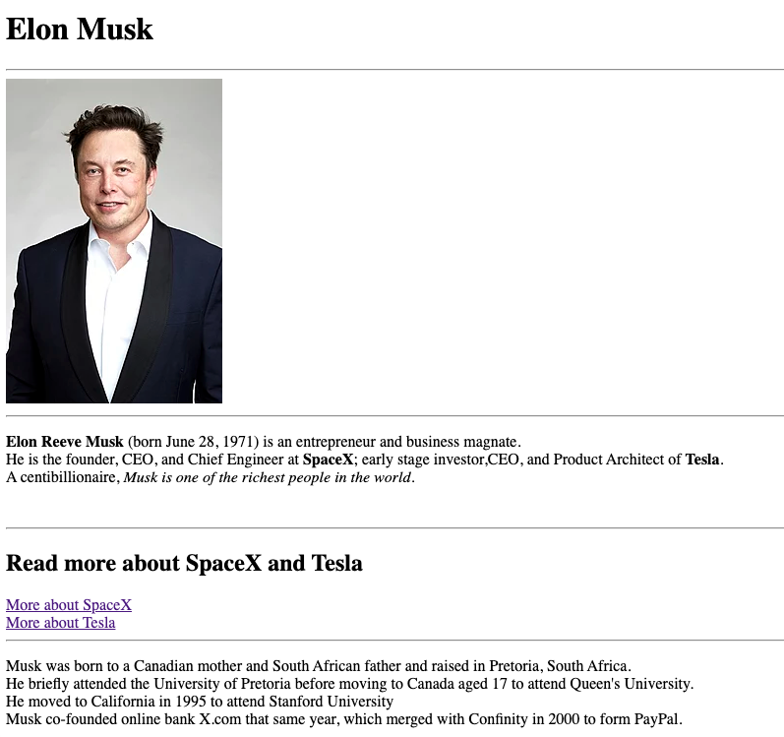
Exercise Create an HTML Page tells briefly about Elon Musk image source = https://upload.wikimedia.org/wikipedia/commons/thumb/8/85/Elon_Musk_Royal_Society_%28crop1%29.jpg/220px-Elon_Musk_Royal_Society_%28crop1%29.jpg SpaceX link = https://www.spacex.com/ Tesla link = https://www.tesla.com/
Elon Reeve Musk (born June 28, 1971) is an entrepreneur and business magnate.
He is the founder, CEO, and Chief Engineer at SpaceX; early-stage investor,CEO, and Product Architect of Tesla
A centibillionaire, Musk is one of the richest people in the world.
Musk was born to a Canadian mother and South African father and raised in Pretoria, South Africa.
He briefly attended the University of Pretoria before moving to Canada aged 17 to attend Queen's University.
He moved to California in 1995 to attend Stanford University
Musk co-founded online bank X.com that same year, which merged with Confinity in 2000 to form PayPal.

Slide 14
HTML attributes
HTML attributes are used to define additional information about the HTML elements
Every HTML elements can have many attributes
Attributes must always be defined in the opening-start tag
Attributes are usually defined in name-value pairs like name=“value”
EXAMPLES
The <a></a> tag defines a hyperlink and the href attribute indicates the link's destination (where it goes)
The <img> tag is used to link an image in an HTML page and
src attribute specifies the path of the image,
width and height attributes specify the width and height of the image
alt attribute specifies an alternate text for the image in case it is not displayed
NOTE: We can also use style attribute with HTML elements to define elements’ color, font, size, background color, alignment, etc.

Slide 15
HTML styles
The style attribute is used with HTML elements to define elements’ color, font, size, background color, alignment, etc.
SYNTAX:
<tagName attribute = “property:value;”></tagName>
<p style = “color:red;”></p>
Use the style attribute for styling HTML elements
Use background-color for background color
Use color for text colors
Use font-family for text fonts
Use font-size for text sizes
Use text-align for text alignment
NOTE: HTML color names = https://htmlcolorcodes.com/color-names/

Slide 16
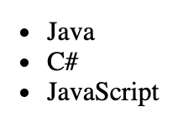
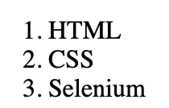
HTML lists
HTML allows us to create 2 types of lists to group a set of related items
1. Unordered HTML List
<ul></ul> tag is used to create unordered list and each item starts with the <li></li> tag
SYNTAX:
<ul> <li>Java</li> <li>C#</li> <li>JavaScript</li> </ul>
2. Ordered HTML List
<ol></ol> tag is used to create ordered list and each item starts with the <li ></li> tag
SYNTAX:
<ol> <li>HTML</li> <li>CSS</li> <li>Selenium</li> </ol>

Slide 17
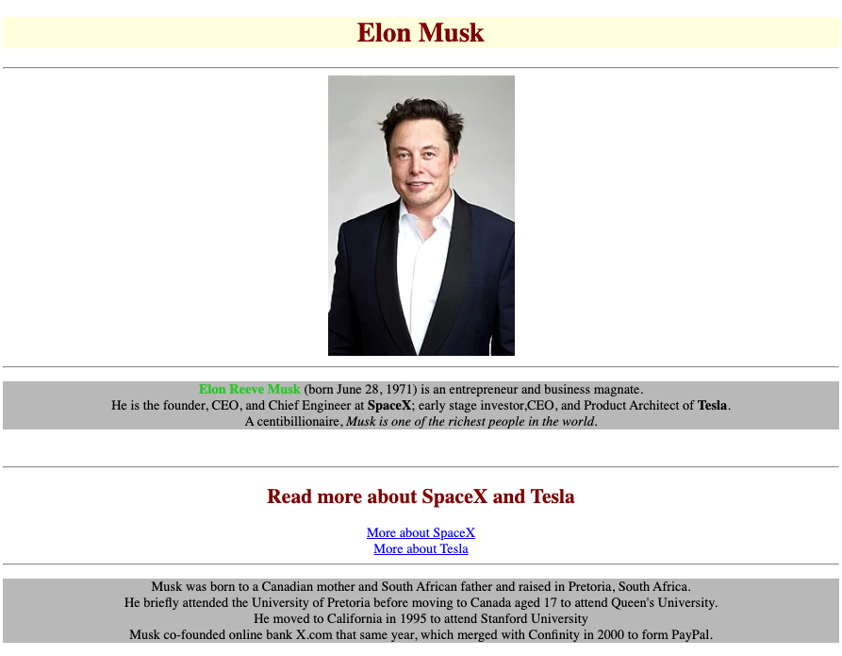
Exercise
Revisit the HTML Page about Elon Musk and add some styles as displayed in the image 1. Center all the body of the HTML document. 2. Style color of “Elon Musk” h1 header to darkred and background-color to lightyellow. 3. Style color of “Elon Reeve Musk” text in paragraph to limegreen. 4. Style color of “Read more about the SpaceX and Tesla” h2 header to darkred. 5. Style color of both hyperlinks to blue. 6. Style background-color of both paragraphs to silver.
Elon Reeve Musk (born June 28, 1971) is an entrepreneur and business magnate.
He is the founder, CEO, and Chief Engineer at SpaceX; early-stage investor,CEO, and Product Architect of Tesla
A centibillionaire, Musk is one of the richest people in the world.
Musk was born to a Canadian mother and South African father and raised in Pretoria, South Africa.
He briefly attended the University of Pretoria before moving to Canada aged 17 to attend Queen's University.
He moved to California in 1995 to attend Stanford University
Musk co-founded online bank X.com that same year, which merged with Confinity in 2000 to form PayPal.

Slide 18
Interview questions and Assignment
What is HTML and the purpose of using HTML?
What is head and body tags used for in HTML documents?
What are tags and elements in an HTML document?
What is the difference between tags and attributes?
Please list the HTML tags you know and explain them shortly.
Write a HTML code to represent your favorite celebrity. Use styling to represent better
GO ABOVE AND BEYOND WITH YOUR ASSIGNMENT!!!

